Slide 1
I’d like to wish you all a warm welcome back to school and hope that 2018 has already started well for you and your families. After a busy Autumn, I’m looking forward to lots of exciting new topics for this Spring term. Please take a few moments to read the following information. Thank you all for your support so far this year and Please remember that I am always happy to meet you or chat after school if you have anything you’d like to discuss.
.
Important notices:
Late arrivals:
If your child arrives late for P.E. please make sure you drop them off either at the office or with a teacher at the place of where P.E. is taking place. They are NOT to walk alone or just be ‘dropped’ off without an adult being notified of their arrival – thank you.
Hats at Playtimes:
Many children are frequently without hats at playtimes. Please do ensure that your child has a hat with them each day, as we do not allow children to play in the sun without them.
Water bottles:
Water will continue to be available if your child runs out of water during the day, courtesy of the PTA water coolers. However, please try to send a large enough bottle that refills are the exception rather than the norm.
General reminders:
PE will continue to take place on Tuesday and Thursday mornings. Children should come to school in their PE kits and change after the lesson. Please ensure that your child has both shorts and a school t shirt to change back in
Homework All homework will be set on a Tuesday and is due the following Monday. This includes weekly maths, literacy or topic and spellings homework. There will also be a home learning project set later in the term.
Important Contact details:
Provo Primary School
PO Box 329
Flamingo Park
Graceway
Providenciales
Tel: 333 5638
Email: info@provoprimary.com
Website: www.provoprimary.com

Slide 2
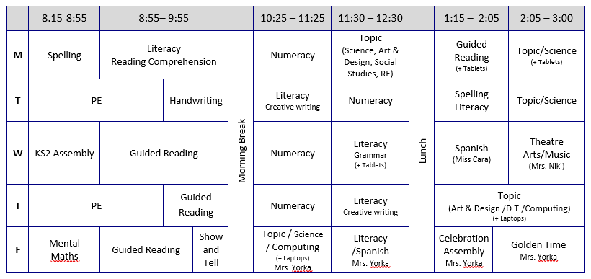
Curriculum and Topic information:
Topics this term: Flamingo class will be exploring 2 new topics this term. We will be learning lots about ELECTRICITY in the first half term. In this science-based topic, children will discover how to build electrical circuits, how to be safe around electricity and much more! We will also become junior archaeologists, as we try to uncover the history of Ancient Rome. The children will consider how we can find out about the past by looking at what has survived from ancient civilisations. As before, our art & design, literacy, science and social studies will be taught through these topics.
Reading: Please ensure that your child’s reading book comes into school each day, whether they are reading from the library or enjoying books from home. The children and I all agree that we really enjoy our guided reading sessions; it’s lovely to sit and read together and discuss books. Finding time to do this at home is invaluable. Please try to continue to listen to and read with your child as often as possible. I am very happy to help with finding the right books in our wonderful school library
Parent volunteers During the Spring term, I will be planning visits and field trips to support our learning. We require a small number of parents to assist with transportation and supervision on these days. Please keep an eye out for information on these trips and I thank you in advance for your help – especially as I am still getting to know the island!

