Slide 1
Welcome back everyone! I hope that you all have had a very relaxing few weeks over the holiday period, and that you’ve already had an excellent start to the New Year! After a fantastic Autumn term, I’m excited to begin a new year of learning in Coral Class. Please take a few moments to read the following information.
Thank you all for your support and interest in our projects so far this year, and I look forward to sharing more with you this term.
Important notices:
Hats at Playtimes:
Many children are frequently without hats at playtimes. Please do ensure that your child has a hat with them each day, as we do not allow children to play in the sun without them. If you would prefer to keep at hat at school, I am happy to provide a ‘Hat Box’ for ease. One less thing to remember!
Water bottles:
Water will continue to be available if your child runs out of water during the day, courtesy of the P.A. water coolers. However, please try to send a large enough bottle that refills are the exception rather than the norm.
Happy Birthday this term to:
Charlie on 6th Jan!
Anna on 28th Jan!
Kaelyn on 18th March!
Hip – Hip – Hooray!
Important Contact details:
Provo Primary School
PO Box 329
Flamingo Park
Graceway
Providenciales
Tel: 333 5638
Email: info@provoprimary.com
www.provoprimaryschool.com
General reminders:
PE will continue to take place on Monday and Wednesday mornings. Children should come to school in their PE kits and change after the lesson. Please ensure that your child brings their water bottle and hat on these days.
Homework: Children did very well with homework in the first term. I will continue to mark homework on a Wednesday and reset on a Thursday. Many homework games and spelling activities do not need to be handed back in – please just use these as an occasional game if you wish. Spellings will be tested more routinely on a Wednesday as part of our book-swap time.

Slide 2
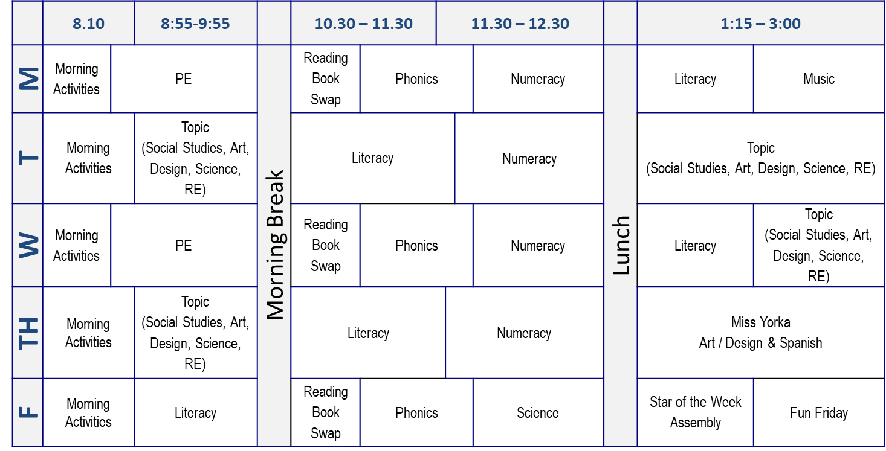
Curriculum and Topic information:
Topics this term: Coral class will be exploring 2 new topics this term. We will be continuing our Family Portrait topic until mid-term. We will think about our families and about growing older healthily. We will explore art and design in the form of family portraits – advance notice: children will be designing and building a frame for a family picture…we will need to collect digital copies of these pictures in the coming weeks.
After the mid term break, we will turn our minds to design and science in the topic Lights, Camera, Action! Children will make simple electrical circuits and explore light and colour mixing. These skills will be applied when making a mini-stage for a finger-puppet show based on their literacy learning. We will also explore music to introduce and accompany their performance. In their computing, children will learn to use recording equipment to capture some of their show!
As before, our art & design, literacy, science and social studies will be taught through these topics. I hope that they inspire all kinds of new and fun learning!
Reading: I have been so pleased to see children’s enthusiasm and independence in reading grow so far this year. We will continue to swap books on Mon, Weds and Fri. I will also begin group reading activities in class, where I can hear your child read more regularly while exploring their comprehension.
Parent volunteers: I have appreciated the interest and support all parents over the Autumn term, especially with our trip. During the Spring and Summer terms, we will be undertaking more educational visits to support our learning. We require a small number of parents to assist with transportation and supervision on these days. Please keep an eye out for information on these trips and I thank you in advance for your help!
As ever, if you have any questions or concerns which you would like to raise, please see me in class before or after school. I am always happy to make an appointment to speak if you require. ~ Mr Toby.

